Slide 1
Binomial Coefficients,
Inclusion-exclusion principle
A
B
C
D

Slide 2
Plan
Binomial coefficients, combinatorial proof
Inclusion-exclusion principle

Slide 3

Binomial Theorem
We can compute the coefficients c_{i} by counting arguments.
e.g.
(expanding by taking either 1 or x in each factor and multiply)
(grouping the terms with the same power and add)
So in this case, c₀ = 1, c₁ = 3, c₂ = 3, c₃ = 1.

Slide 4
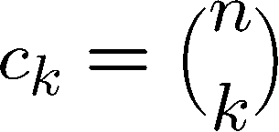
Binomial Theorem
We can compute the coefficients c_{i} by counting arguments.
n factors
Each term corresponds to selecting 1 or x from each of the n factors.
The coefficient c_{k} is equal to the number of terms with exactly k x’s.
Each term with exactly k x’s corresponds to choosing the k positions of x.
Therefore,
These are called the binomial coefficients.

Slide 5
Binomial Theorem
(1+X)⁰ =
1
(1+X)¹ =
1 + 1X
(1+X)² =
1 + 2X + 1X²
(1+X)³ =
1 + 3X + 3X² + 1X³
(1+X)⁴ =
1 + 4X + 6X² + 4X³ + 1X⁴
We can see that a coefficient is the sum of two coefficients in the previous level.
This is called the Pascal’s formula and we will prove it soon.

Slide 6
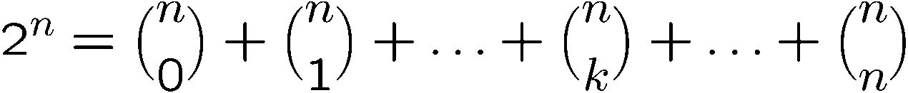
Binomial Coefficients
In general we have the following identity:
because if we choose k x’s then there are n-k y’s.
Corollary:
When x=1, y=1, it implies that
The sum of the binomial coefficients is equal to 2^{n}.

Slide 7
Binomial Coefficients
In general we have the following identity:
Corollary:
When x=-1, y=1, it implies that
The sum of “odd” binomial coefficients is equal to
the sum of “even” binomial coefficients.

Slide 8
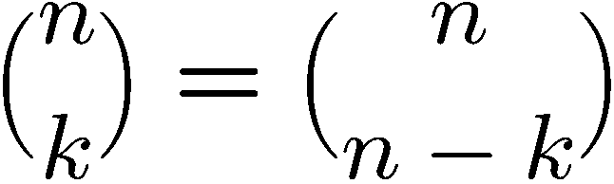
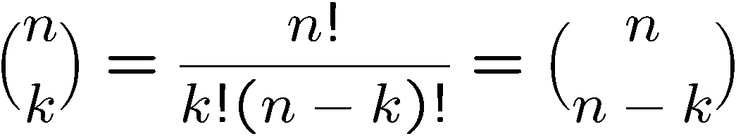
Proving Identities
One can often prove identities about binomial coefficients by a counting argument.
Direct proof:
Combinatorial proof:
Number of ways to choose k items from n items
= number of ways to choose n-k items from n items

Slide 9
Finding a Combinatorial Proof
A combinatorial proof is an argument that establishes an algebraic fact by relying on counting principles.
Many such proofs follow the same basic outline:
1. Define a set S.
2. Show that |S| = n by counting one way.
3. Show that |S| = m by counting another way.
4. Conclude that n = m.
Double counting

Slide 10
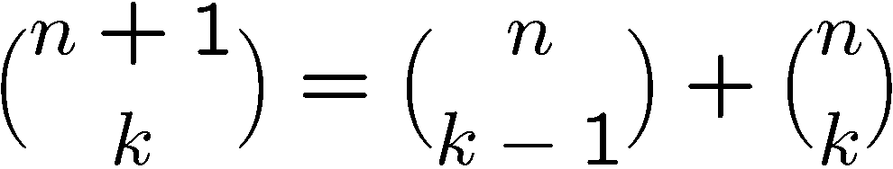
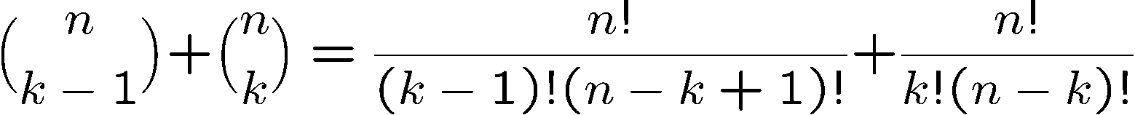
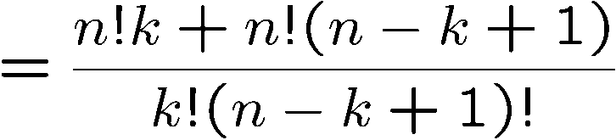
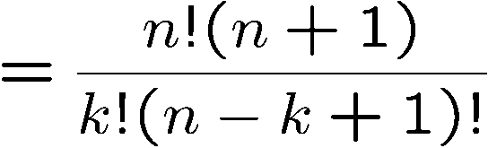
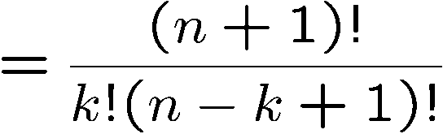
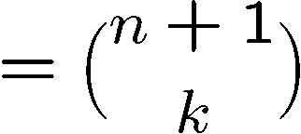
Proving Identities
Pascal’s Formula
Direct proof:

Slide 11
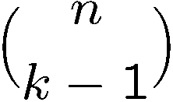


Proving Identities
Pascal’s Formula
Combinatorial proof:
The LHS is number of ways to choose k elements from n+1 elements.
Let the first element be x.
If we choose x, then we need to choose k-1 elements
from the remaining n elements, and number of ways to do so is
If we don’t choose x, then we need to choose k elements
from the remaining n elements, and number of ways to do so is
This partitions the ways to choose k elements from n+1 elements,
therefore

Slide 12
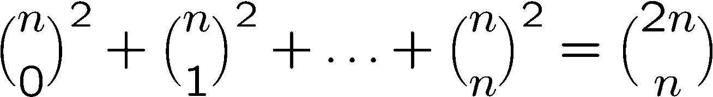
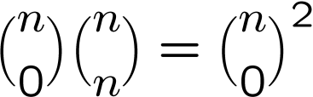
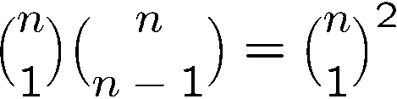
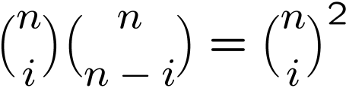
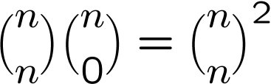
Combinatorial Proof
Consider we have 2n balls, n of them are red, and n of them are blue.
The RHS is number of ways to choose n balls from the 2n balls.
To choose n balls, we can
- choose 0 red ball and n blue balls, number of ways =
- choose 1 red ball and n-1 blue balls, number of ways =
…
choose i red balls and n-i blue balls, number of ways =
…
choose n red balls and 0 blue ball, number of ways =
Hence number of ways to choose n balls is also equal to the LHS.

Slide 13
Another Way to Combinatorial Proof (Optional)
We can also prove the identity by comparing a coefficient of two polynomials.
Consider the identity
Consider the coefficient of x^{n} in these two polynomials.
Clearly the coefficient of x^{n} in (1+x)^{2n} is equal to the RHS.
So the coefficient of x^{n} in (1+x)^{n}(1+x)^{n} is equal to the LHS.

Slide 14
Exercises
Prove that
Give a combinatorial proof of the following identify.
Can you give a direct proof of it?

Slide 15
Plan
Binomial coefficients, combinatorial proof
Inclusion-exclusion principle

Slide 16
Sum Rule
If sets A and B are disjoint, then
|A ∪ B| = |A| + |B|
A
B
  What if A and B are not disjoint?

Slide 17

Inclusion-Exclusion (2 sets)
For two arbitrary sets A and B
A
B

Slide 18
Inclusion-Exclusion (2 sets)
Let S be the set of integers from 1 through 1000 that are multiples of 3 or multiples of 5.
Let A be the set of integers from 1 to 1000 that are multiples of 3.
Let B be the set of integers from 1 to 1000 that are multiples of 5.
It is clear that S is the union of A and B,
but notice that A and B are not disjoint.
A
B
|A| = 1000/3 = 333
|B| = 1000/5 = 200
A Å B is the set of integers that are multiples of 15, and so |A Å B| = 1000/15 = 66
So, by the inclusion-exclusion principle, we have |S| = |A| + |B| - |A Å B| = 467.

Slide 19
Inclusion-Exclusion (3 sets)
|A [ B [ C| = |A| + |B| + |C|
– |A Å B| – |A Å C| – |B Å C|
+ |A Å B Å C|
A
B
C

Slide 20
Inclusion-Exclusion (3 sets)
From a total of 50 students:
|A|
30 know Java
18 know C++
26 know C#
9 know both Java and C++
16 know both Java and C#
8 know both C++ and C#
47 know at least one language.
|B|
|C|
How many know none?
How many know all?
|A Å B|
|A Å C|
|B Å C|
|A Å B Å C|
|A [ B [ C|
|A [ B [ C| = |A| + |B| + |C| – |A Å B| – |A Å C| – |B Å C| + |A Å B Å C|
47 = 30 + 18 + 26 – 9 – 16 – 8 + |A Å B Å C|
|A Å B Å C| = 6

Slide 21
Inclusion-Exclusion (4 sets)
|A [ B [ C [ D| = |A| + |B| + |C| + |D|
– |A Å B| – |A Å C| – |A Å D| – |B Å C| – |B Å D| – |C Å D|
+ |A Å B Å C| + |A Å B Å D| + |A Å C Å D| + |B Å C Å D|
– |A Å B Å C Å D |
A
B
C
D

Slide 22
Inclusion-Exclusion (n sets)
What is the inclusion-exclusion formula for the union of n sets?

Slide 23
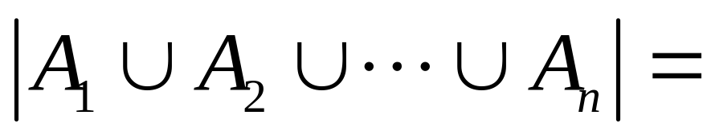
Inclusion-Exclusion (n sets)
sum of sizes of all single sets
– sum of sizes of all 2-set intersections
+ sum of sizes of all 3-set intersections
– sum of sizes of all 4-set intersections
…
+ (–1)^{n+1} × sum of sizes of intersections of all n sets

Slide 24
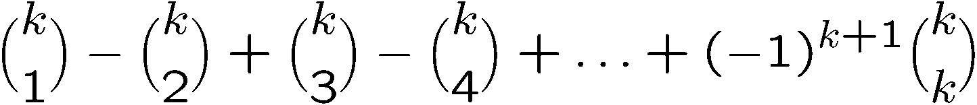
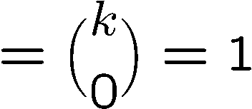
Inclusion-Exclusion (n sets)
We give a proof of the inclusion exclusion formula.
Consider an element x in the intersection of A₁, A₂, …, A_{k}.
What is the contribution of this element to the RHS of the formula?
It is counted +1 in |A₁|, |A₂|, …, |A_{k}|, so it is counted +k for single sets.
It is counted -1 in -|A₁ÅA₂|, -|A₁ÅA₃|, …, -|A_{k-1}ÅA_{k}|,
so it is counted –(k choose 2) for two set intersections.
It is counted +1 in |A₁ÅA₂ÅA₃|, …, |A_{k-2}ÅA_{k-1}ÅA_{k}|,
so it is counted +(k choose 3) for three set intersections.
And so on……
So it’s contribution to the formula is
see slide 7
Each element is counted exactly once, and so the formula is correct.

Slide 25


Applications (Optional)
In a Christmas party, everyone brings his/her present.
There are n people and so there are totally n presents.
Suppose the host collects and shuffles all the presents.
Now everyone picks a random present.
What is the probability that no one picks his/her own present?
Using inclusion-exclusion we can show that the answer is 1/e where e=2.71828…
Given a number n, how many numbers from 1 to n are relatively prime to n?
Let
Using inclusion-exclusion we can show that the answer is n(1-1/p₁)(1-1/p₂)…(1-1/p_{n})

Slide 26
Quick Summary
We have studied how to determine the size of a set directly.
The basic rules are the sum rule, product rule, and the generalized product rule.
We apply these rules in counting permutations and combinations,
which are then used to count other objects like poker hands.
Then we prove the binomial theorem and study combinatorial proofs of identities.
Finally we learn the inclusion-exclusion principle and see some applications.
Later we will learn how to count “indirectly” by “mapping”.

